Slide 2
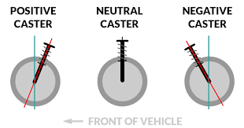
Caster
Caster is a crucial geometric property of a vehicle's suspension, particularly important in racing cars. It's not a physical component like a caster wheel, but rather an angle measurement. Caster angle is the angle between the vertical axis of the wheel and the steering axis when viewed from the side of the car. Positive caster means the steering axis is tilted backward.

Slide 3
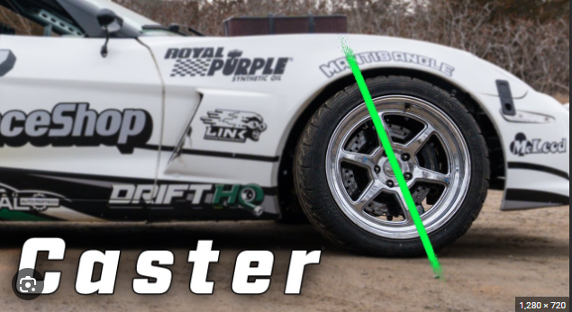
Impact of Caster Angle on Racing Cars
Directional Stability: Positive caster tends to improve directional stability, making the car track straighter. This is beneficial for high-speed tracks.
Steering Effort: Increasing caster angle generally increases steering effort. This is a trade-off to consider when balancing stability and driver input.
Turn-in Response: Excessive positive caster can slow down turn-in response.
Tire Wear: Caster angle can affect tire wear patterns.

Slide 4
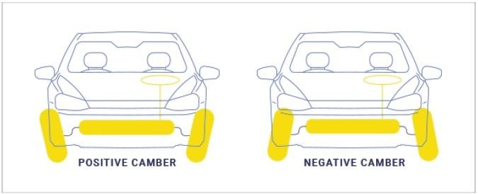
CAMBER
Camber is the angle of a tire relative to the vertical axis of the car when viewed from the front.
It's another crucial factor in racing car setup.

Slide 5
How Camber Affects the Tyre Life
If the camber is out of limit, it will cause tyre wear on one side of the tyre’s tread.
If the camber is negative, then the tyre will wear on the inside of the tread.
If the camber is different from side to side it can cause a tyre pulling problem.
If camber is positive then vehicle will pull with the respective side.
On many front-wheel drive vehicles, the camber is not adjustable. If the camber is out on these cars, it indicates that something is worn or bent, possibly from an accident, and must be repaired or replaced. On many vehicles, the camber changes with different road speeds. This is because aerodynamic forces cause a change in riding height from the height of a vehicle at rest. Because of this, riding height should be checked and problems are corrected before setting camber.

Slide 6
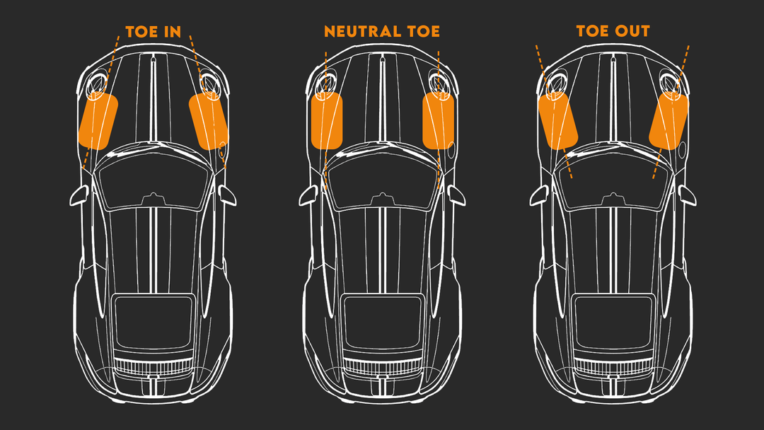
TOE
Toe refers to the angle at which the wheels point
relative to each other when viewed from above.
Types of Toe
Toe-in: The front of the tires points inward.
Toe-out: The front of the tires points outward.

Slide 7
Impact of Toe on Racing Cars
Turn-in response: Toe-in can improve turn-in response but can also increase tire wear.
Stability: Toe-out can improve straight-line stability but can reduce cornering grip.
Tire wear: Excessive toe in either direction can accelerate tire wear.

Slide 8
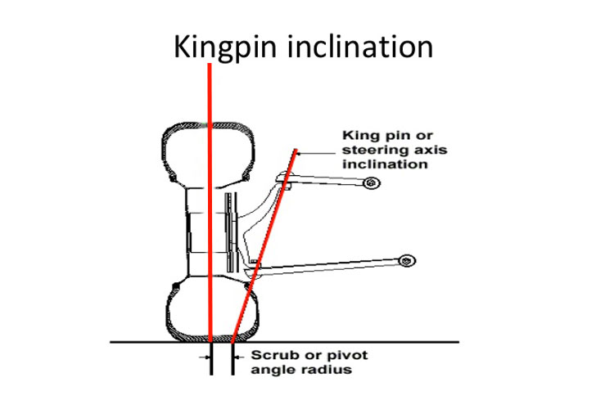
Kingpin Angle
Kingpin angle is another crucial element of suspension geometry. It's the angle between the vertical axis and the steering axis when viewed from the front of the car.

Slide 9
load transfer

Slide 10
Load transfer is a fundamental concept in racing car dynamics. It refers to the shift in weight distribution of a car when it accelerates, brakes, or corners. This redistribution of weight significantly affects the car's handling and grip.
How Load Transfer Works
Acceleration: Weight shifts towards the rear, reducing grip at the front tires.
Braking: Weight shifts towards the front, reducing grip at the rear tires.
Cornering: Weight shifts to the outer wheels, increasing grip on the outside and reducing grip on the inside.

Slide 11
Components of a suspension system

Slide 12
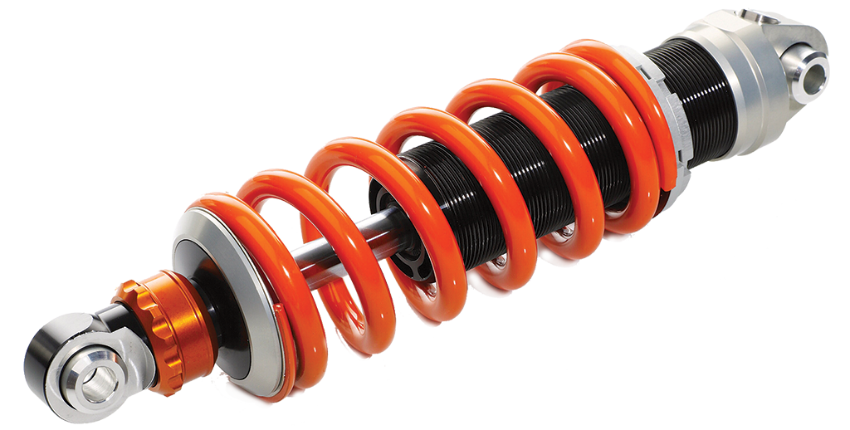
springs
spring
Suspension springs are essential components in a vehicle's suspension system. Their primary function is to absorb the impact from road irregularities, providing a smoother ride and maintaining tire contact with the road.

Slide 13
Dampers (shock absorbers)
dampers
Dampers, also known as shock absorbers, are crucial components in a vehicle's suspension system.
They work in conjunction with springs to control the vehicle's movement, providing a smooth and stable ride.

Slide 14
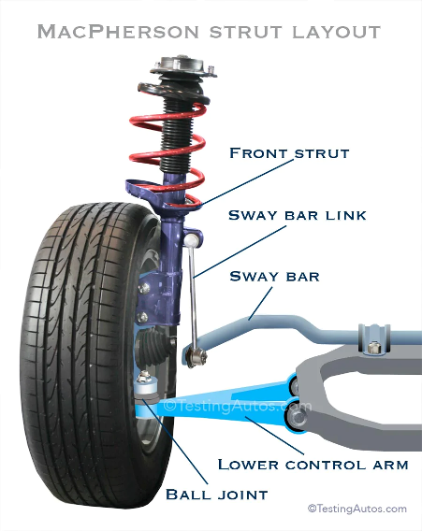
Control arms
Control arms are essential components in a vehicle's suspension system. They connect the wheels to the vehicle's frame, controlling the wheel's position and movement.

Slide 15
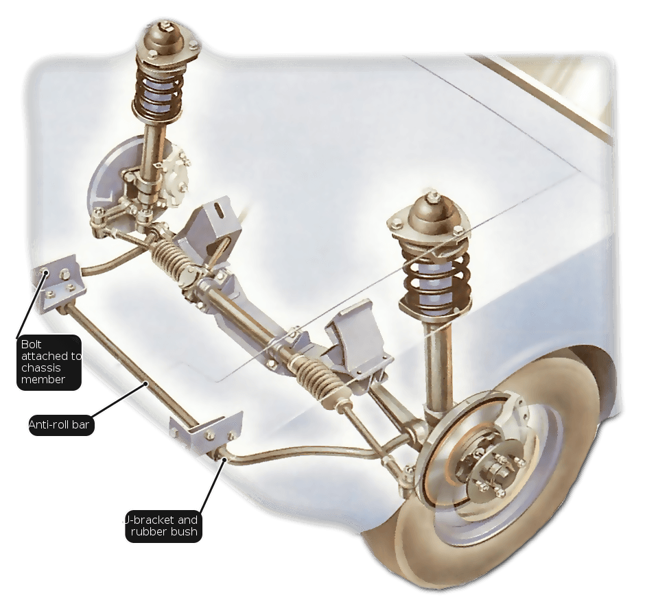
ARB (anti roll bar)
An anti-roll bar or stabilizer bar is a component in a vehicle's suspension system designed to reduce body roll. Body roll is the tendency of a vehicle to lean excessively when cornering.
How it Works?
An anti-roll bar is essentially a torsion bar, a thick metal bar shaped like a "U." It's connected to the control arms on opposite sides of the axle. When one wheel encounters a bump or the car corners, the anti-roll bar resists twisting, which helps to keep the vehicle level.

Slide 16
Common suspension types

Slide 17
Macpherson Strut
The MacPherson strut combines the functions of a shock absorber and a spring into a single unit. This unit is attached to the car's body at the top and to the steering knuckle at the bottom. A lower control arm is used to locate the wheel laterally.

Slide 18
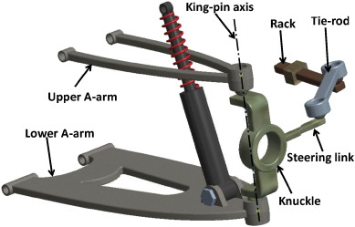
Double wishbone
A double wishbone suspension is a type of independent suspension system that uses two wishbone-shaped arms (or control arms) to locate the wheel. It's considered one of the most advanced and adjustable suspension systems.
The upper and lower control arms are attached to the vehicle's chassis at one end and to the steering knuckle at the other. These arms control the wheel's movement in various directions. The shock absorber and spring are usually mounted to the lower control arm.

